Slide 1

Module 4.3 - Memory Model and Locality
Tiled Matrix Multiplication

Slide 2
Objective
To understand the design of a tiled parallel algorithm for matrix multiplication
Loading a tile
Phased execution
Barrier Synchronization

Slide 3
Matrix Multiplication
Data access pattern
Each thread - a row of M and a column of N
Each thread block – a strip of M and a strip of N
N
WIDTH
M
P
BLOCK_WIDTHE
Row
WIDTH
BLOCK_WIDTH
WIDTH
WIDTH
Col

Slide 4
Tiled Matrix Multiplication
Break up the execution of each thread into phases
so that the data accesses by the thread block in each phase are focused on one tile of M and one tile of N
The tile is of BLOCK_SIZE elements in each dimension
N
WIDTH
M
P
BLOCK_WIDTHE
Row
WIDTH
BLOCK_WIDTH
WIDTH
WIDTH
Col

Slide 5
Loading a Tile
All threads in a block participate
Each thread loads one M element and one N element in tiled code

Slide 6
Phase 0 Load for Block (0,0)
N_{0,0}
N_{0,1}
N_{0,2}
N_{0,3}
N_{0,0}
N_{0,1}
Shared Memory
N_{1,0}
N_{1,1}
N_{1,2}
N_{1,3}
N_{1,0}
N_{1,1}
N_{2,0}
N_{2,1}
N_{2,2}
N_{2,3}
N_{3,0}
N_{3,1}
N_{3,2}
N_{3,3}
Shared Memory
M_{0,0}
M_{0,1}
M_{0,2}
M_{0,3}
M_{0,0}
M_{0,1}
P_{0,0}
P_{0,1}
P_{0,2}
P_{0,3}
M_{1,0}
M_{1,1}
M_{1,2}
M_{1,3}
M_{1,0}
M_{1,1}
P_{1,0}
P_{1,1}
P_{1,2}
P_{1,3}
M_{2,0}
M_{2,1}
M_{2,2}
M_{2,3}
P_{2,0}
P_{2,1}
P_{2,2}
P_{2,3}
M_{3,0}
M_{3,1}
M_{3,2}
M_{3,3}
P_{3,0}
P_{3,1}
P_{3,2}
P_{3,3}

Slide 7
Phase 0 Use for Block (0,0) (iteration 0)
N_{0,0}
N_{0,1}
N_{0,2}
N_{0,3}
N_{0,0}
N_{0,1}
Shared Memory
N_{1,0}
N_{1,1}
N_{1,2}
N_{1,3}
N_{1,0}
N_{1,1}
N_{2,0}
N_{2,1}
N_{2,2}
N_{2,3}
N_{3,0}
N_{3,1}
N_{3,2}
N_{3,3}
Shared Memory
M_{0,0}
M_{0,1}
M_{0,2}
M_{0,3}
M_{0,0}
M_{0,1}
P_{0,0}
P_{0,1}
P_{0,2}
P_{0,3}
M_{1,0}
M_{1,1}
M_{1,2}
M_{1,3}
M_{1,0}
M_{1,1}
P_{1,0}
P_{1,1}
P_{1,2}
P_{1,3}
M_{2,0}
M_{2,1}
M_{2,2}
M_{2,3}
P_{2,0}
P_{2,1}
P_{2,2}
P_{2,3}
M_{3,0}
M_{3,1}
M_{3,2}
M_{3,3}
P_{3,0}
P_{3,1}
P_{3,2}
P_{3,3}

Slide 8
Phase 0 Use for Block (0,0) (iteration 1)
N_{0,0}
N_{0,1}
N_{0,2}
N_{0,3}
N_{0,0}
N_{0,1}
Shared Memory
N_{1,0}
N_{1,1}
N_{1,2}
N_{1,3}
N_{1,0}
N_{1,1}
N_{2,0}
N_{2,1}
N_{2,2}
N_{2,3}
N_{3,0}
N_{3,1}
N_{3,2}
N_{3,3}
Shared Memory
M_{0,0}
M_{0,1}
M_{0,2}
M_{0,3}
M_{0,0}
M_{0,1}
P_{0,0}
P_{0,1}
P_{0,2}
P_{0,3}
M_{1,0}
M_{1,1}
M_{1,2}
M_{1,3}
M_{1,0}
M_{1,1}
P_{1,0}
P_{1,1}
P_{1,2}
P_{1,3}
M_{2,0}
M_{2,1}
M_{2,2}
M_{2,3}
P_{2,0}
P_{2,1}
P_{2,2}
P_{2,3}
M_{3,0}
M_{3,1}
M_{3,2}
M_{3,3}
P_{3,0}
P_{3,1}
P_{3,2}
P_{3,3}

Slide 9
Phase 1 Load for Block (0,0)
N_{0,0}
N_{0,1}
N_{0,2}
N_{0,3}
N_{1,0}
N_{1,1}
N_{1,2}
N_{1,3}
N_{2,0}
N_{2,1}
N_{2,2}
N_{2,3}
N_{2,0}
N_{2,1}
Shared Memory
N_{3,0}
N_{3,1}
N_{3,2}
N_{3,3}
N_{3,0}
N_{3,1}
Shared Memory
M_{0,0}
M_{0,1}
M_{0,2}
M_{0,3}
M_{0,2}
M_{0,3}
P_{0,0}
P_{0,1}
P_{0,2}
P_{0,3}
M_{1,0}
M_{1,1}
M_{1,2}
M_{1,3}
M_{1,2}
M_{1,3}
P_{1,0}
P_{1,1}
P_{1,2}
P_{1,3}
M_{2,0}
M_{2,1}
M_{2,2}
M_{2,3}
P_{2,0}
P_{2,1}
P_{2,2}
P_{2,3}
M_{3,0}
M_{3,1}
M_{3,2}
M_{3,3}
P_{3,0}
P_{3,1}
P_{3,2}
P_{3,3}

Slide 10
Phase 1 Use for Block (0,0) (iteration 0)
N_{0,0}
N_{0,1}
N_{0,2}
N_{0,3}
N_{1,0}
N_{1,1}
N_{1,2}
N_{1,3}
N_{2,0}
N_{2,1}
N_{2,2}
N_{2,3}
N_{2,0}
N_{2,1}
Shared Memory
N_{3,0}
N_{3,1}
N_{3,2}
N_{3,3}
N_{3,0}
N_{3,1}
Shared Memory
M_{0,0}
M_{0,1}
M_{0,2}
M_{0,3}
M_{0,2}
M_{0,3}
P_{0,0}
P_{0,1}
P_{0,2}
P_{0,3}
M_{1,0}
M_{1,1}
M_{1,2}
M_{1,3}
M_{1,2}
M_{1,3}
P_{1,0}
P_{1,1}
P_{1,2}
P_{1,3}
M_{2,0}
M_{2,1}
M_{2,2}
M_{2,3}
P_{2,0}
P_{2,1}
P_{2,2}
P_{2,3}
M_{3,0}
M_{3,1}
M_{3,2}
M_{3,3}
P_{3,0}
P_{3,1}
P_{3,2}
P_{3,3}

Slide 11
Phase 1 Use for Block (0,0) (iteration 1)
N_{0,0}
N_{0,1}
N_{0,2}
N_{0,3}
N_{1,0}
N_{1,1}
N_{1,2}
N_{1,3}
N_{2,0}
N_{2,1}
N_{2,2}
N_{2,3}
N_{2,0}
N_{2,1}
Shared Memory
N_{3,0}
N_{3,1}
N_{3,2}
N_{3,3}
N_{3,0}
N_{3,1}
Shared Memory
M_{0,0}
M_{0,1}
M_{0,2}
M_{0,3}
M_{0,2}
M_{0,3}
P_{0,0}
P_{0,1}
P_{0,2}
P_{0,3}
M_{1,0}
M_{1,1}
M_{1,2}
M_{1,3}
M_{1,2}
M_{1,3}
P_{1,0}
P_{1,1}
P_{1,2}
P_{1,3}
M_{2,0}
M_{2,1}
M_{2,2}
M_{2,3}
P_{2,0}
P_{2,1}
P_{2,2}
P_{2,3}
M_{3,0}
M_{3,1}
M_{3,2}
M_{3,3}
P_{3,0}
P_{3,1}
P_{3,2}
P_{3,3}

Slide 12
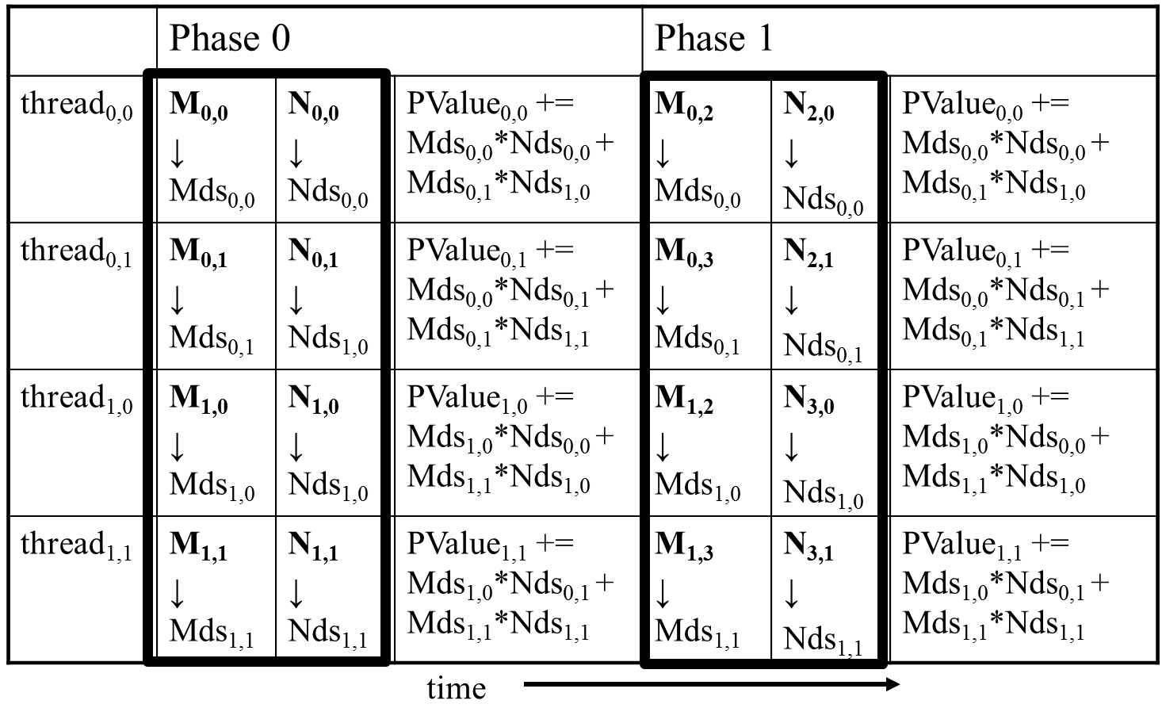
Execution Phases of Toy Example

Slide 13
Execution Phases of Toy Example (cont.)
Shared memory allows each value to be accessed by multiple threads

Slide 14
Barrier Synchronization
Synchronize all threads in a block
__syncthreads()
All threads in the same block must reach the __syncthreads() before any of the them can move on
Best used to coordinate the phased execution tiled algorithms
To ensure that all elements of a tile are loaded at the beginning of a phase
To ensure that all elements of a tile are consumed at the end of a phase

Slide 15
The GPU Teaching Kit is licensed by NVIDIA and the University of Illinois under the Creative Commons Attribution-NonCommercial 4.0 International License.

